Slide 1
Structure Charts
Agenda:
Use of Structure Charts
Symbols
How to create

Slide 2
Structure Chart Use
Describe functions and sub-functions of each part of system (in more detail than a DFD)
Show relationships between common and unique modules of a computer program
Hierarchical, Modular structure
  Each layer in a program performs specific activities
  Each module performs a specific function

Slide 3
Structure Chart Symbols
Structure Chart symbols represent
Modules (sequential logic)
Conditions (decision logic)
Loops (iterative logic)
Data couples
Control couples

Slide 4
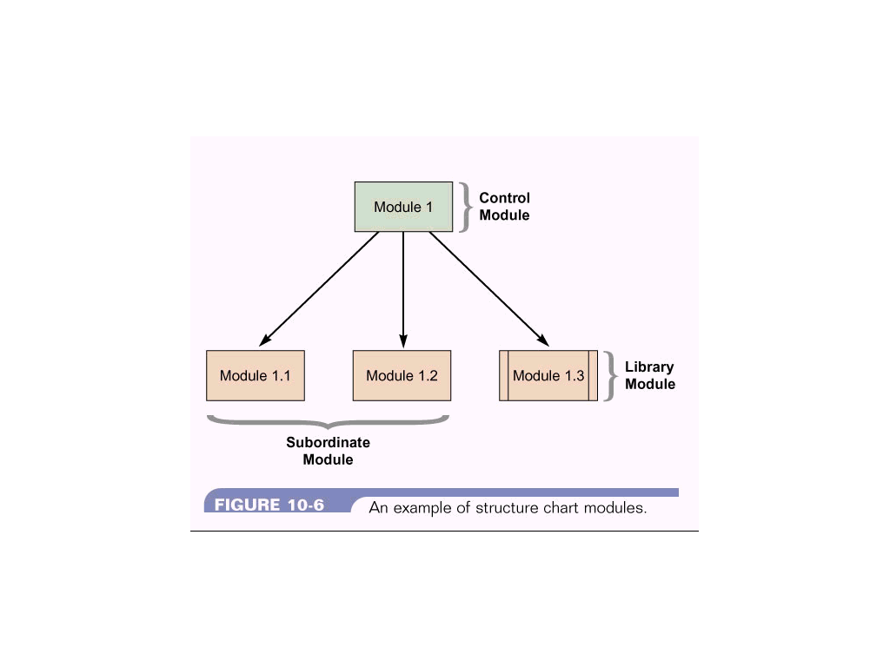
Structure Chart - Module
Rectangle represents a module (program or subroutine)
Control Modules (mainline) branch to sub-modules
Library modules are reusable and can be invoked from more than one Control Module elsewhere in the system

Slide 5
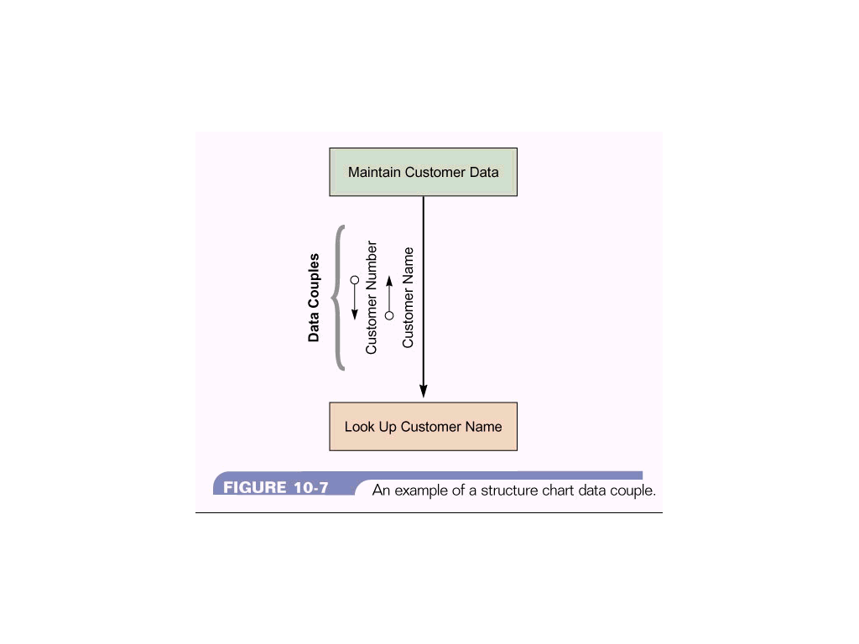
Structure Chart - Data Couple
Arrow with an empty circle
Shows the data one module passes to another

Slide 6
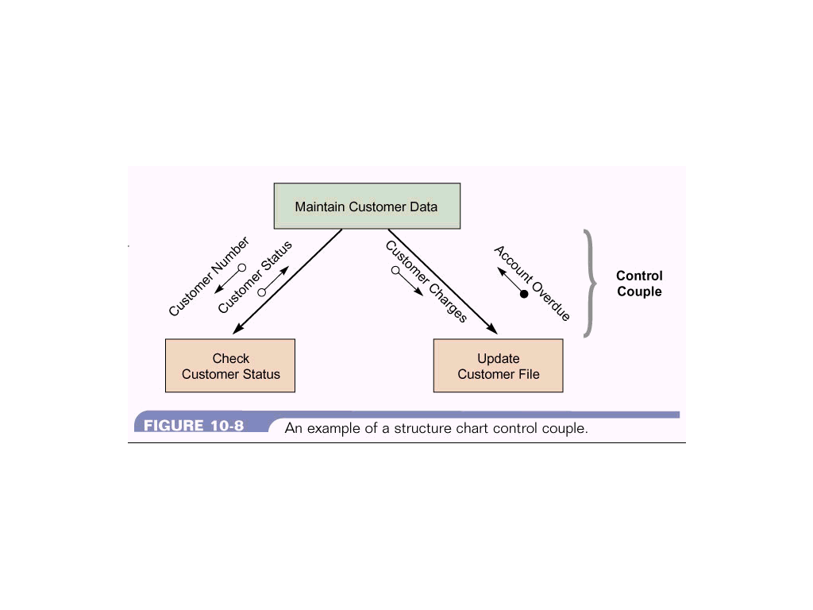
Structure Chart - Control Couple
Arrow with filled circle
Shows a message (flag) which one module sends to another
Module uses a flag to signal a specific condition or action to
another module

Slide 7
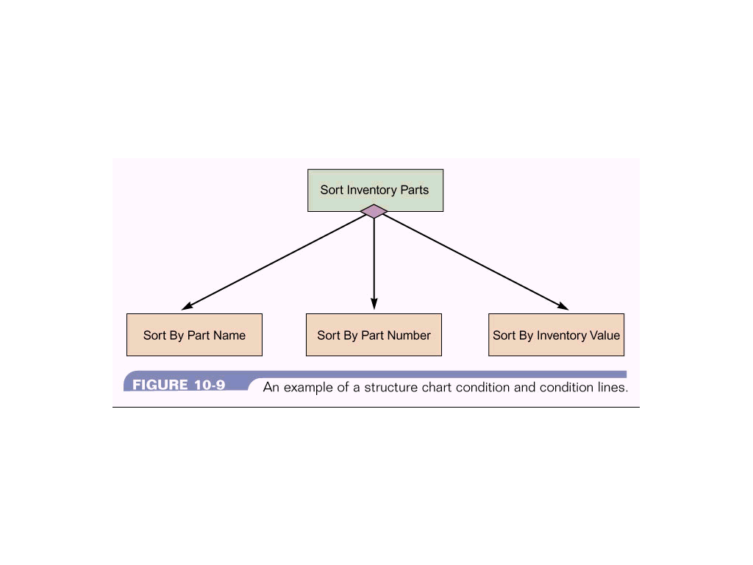
Structure Chart - Condition
A line with a diamond
Indicates that a control module determines which
subordinate module will be invoked

Slide 8
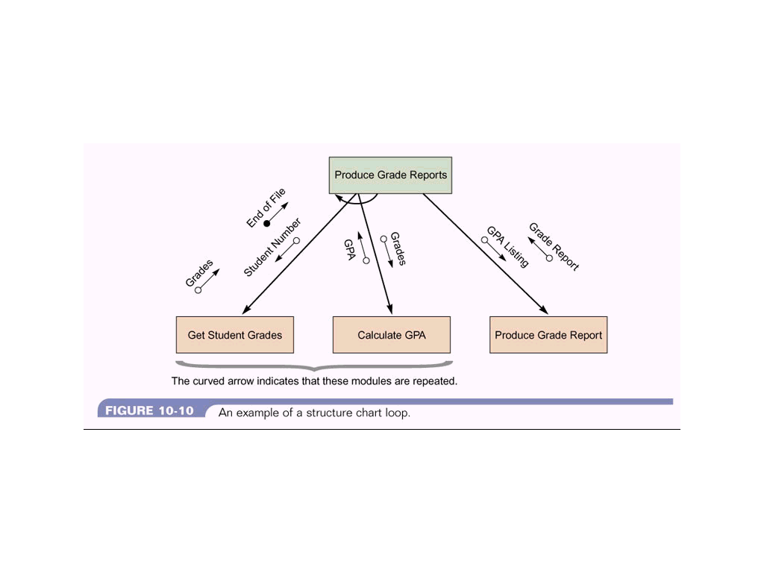
Structure Chart - Loop
A curved arrow representing a loop
One or more modules are repeated

Slide 9
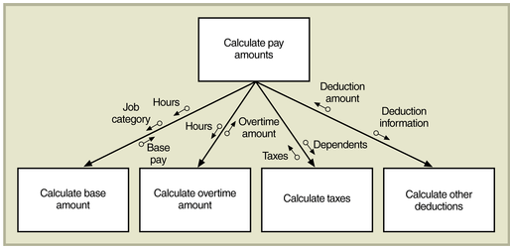
Structure Chart for
Calculate Pay Amount Routine
Figure 9-9

Slide 10
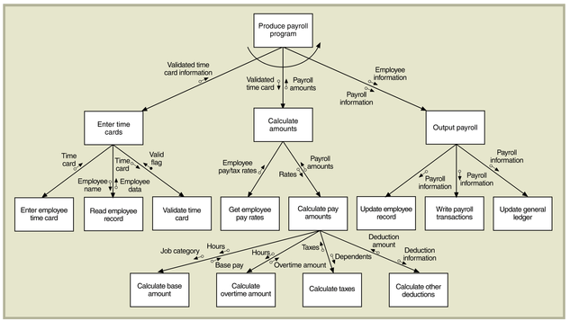
Structure Chart for Entire
Calculate Payroll Program
Figure 9-11

Slide 11
Steps in drawing a structure chart
Review the DFDs and object models
Identify modules and relationships
Add couples, loops, and conditions
Analyze the structure chart, the DFDs, and the data dictionary
Example: Order System DFD
Order System Structure Chart

Slide 12
Summary - Structure Charts
  Show the relationships among program modules
  Structure Chart consists of:
    Modules - Related program code organized into small units that are easy to understand and maintain
    Data couples - Data passed between modules
    Control couples - Data passed between modules that indicates a condition or action to another module (e.g. End of File)
    Conditions - determines what subordinate module a control module will run
    Loops - Indicates one or more subordinate modules are repeated
  Structure Charts are based on the DFD and Data Dictionary

